Slide 1
2D Transformation
2-D geometrical transforms: Translation, scaling, rotation, reflection and shear transformations, matrix representations and homogeneous coordinates, composite transforms, transformations between coordinate systems.

Slide 2
Transformation
Changing position, size, shape and orientation of an object on display is called Transformation.
The basic transformation includes three different transformation, which are as follows
Translation
Rotation
Scaling
These three transformation are known as basic transformation as with combination of these we can obtain any transformation.
Later, two more transformations are added to the list, which are as follows:
Reflection
Shear
We will discuss about these transformation in details.

Slide 3
Transformation types
Translate according to vector v:
t = p + v
Scale with factor s:
s = sp
Rotate over angle α:
r_{x} = cos(α)p_{x} - sin(α)p_{y}
r_{y} = sin(α)p_{x} + cos(α)p_{y}
y
s
r
t
v
α
p
x

Slide 4
Homogeneous coordinates
Unified representation of rotation, scaling, translation
Unified representation of points and vectors
Compact representation for sequences of transformations
Here: convenient notation, much more to it

Slide 5
Homogeneous coordinates
Extra coordinate added:
p = (p_{x} , p_{y} , p_{w}) or
x = (x, y, w)
Cartesian coordinates: divide by w
x = (x/w, y/w)
Here: for a point w = 1, for a vector w = 0

Slide 6
Matrix Representation
Represent a 2D Transformation by a Matrix
Apply the Transformation to a Point
Represent a 2D Transformation by a Matrix
Apply the Transformation to a Point
Transformation
Matrix
Point

Slide 7
2×2 Matrices
What types of transformations can be represented with a 2×2 matrix?
2D Identity
2D Scaling
cgvr.korea.ac.kr

Slide 8
2×2 Matrices
What types of transformations can be represented with a 2×2 matrix?
2D Rotation
2D Shearing

Slide 9
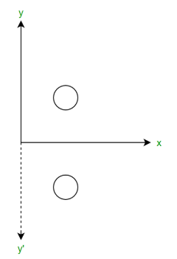
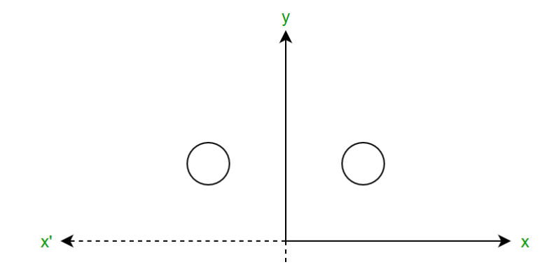
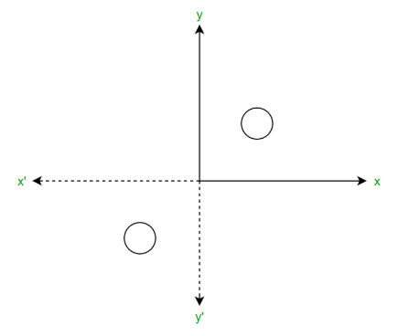
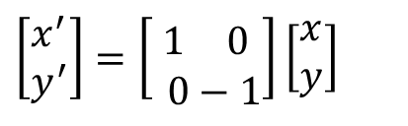

2×2 Matrices
Reflections
2D Mirror over X axis
2D Mirror over Y axis
2D Mirror over (0,0)
$$x^{′}=x \\ y^{′}=−y$$
$$\left[\begin{aligned}&x^{′} \\ &y^{′}\end{aligned}\right]=\left[\begin{aligned}& 1 0 \\ & 0−1\end{aligned}\right]\left[\begin{aligned}&x \\ &y\end{aligned}\right]$$

Slide 10
Reflection
Reflection with respect to the axis
• x • y • xy
y
1
y
y
1
1’
1’
2
3
2
3
3’
2
3’
2
x
x
3
x
2’
3’
1
1’
2

Slide 11
Matrices for transformation

Slide 12
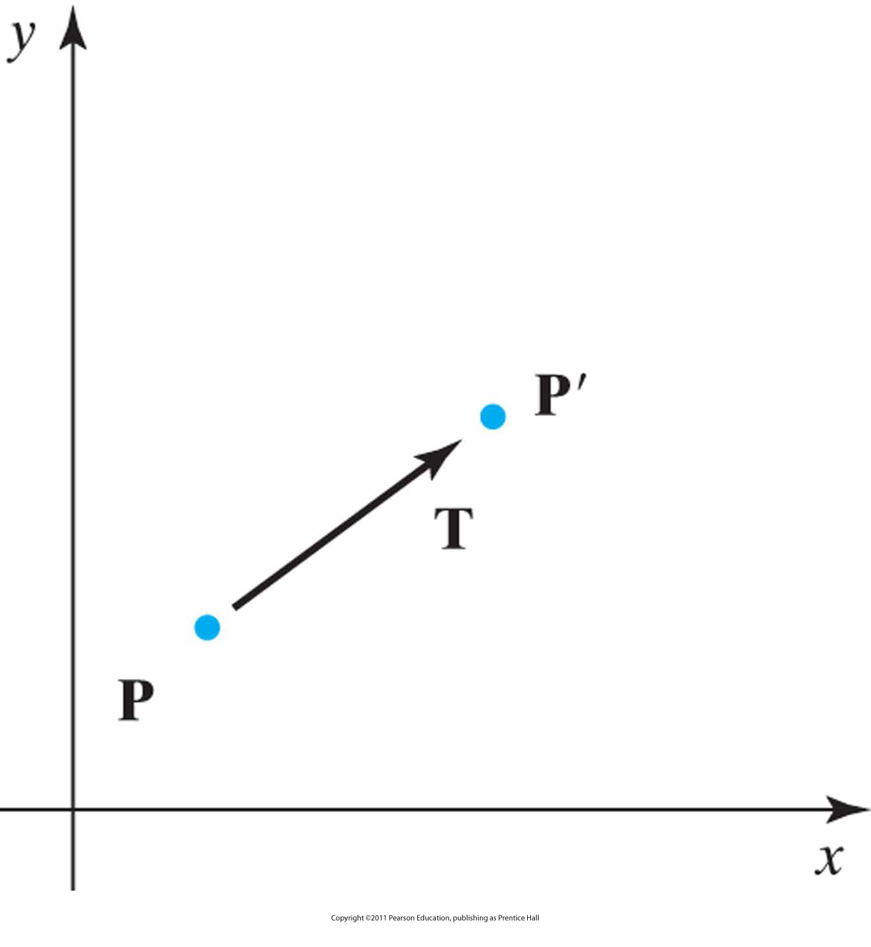
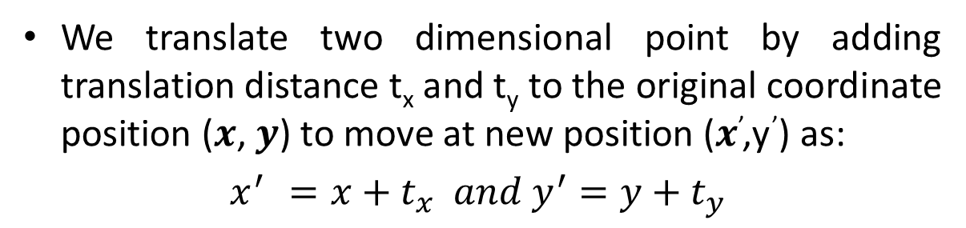
Translation matrix
We translate two dimensional point by adding translation distance t_{x} and t_{y} to the original coordinate position (𝒙, 𝒚) to move at new position (𝒙’,y’) as:
$x^{′ }=x+t_{x} and y^{′}=y+t_{y}$

Slide 13
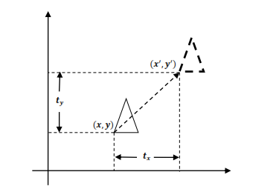
Q: Given a square with coordinate points A(0, 3), B(3, 3), C(3, 0), D(0, 0). Apply the translation with distance 1 towards X axis and 1 towards Y axis. Obtain the new coordinates of the square.

Slide 14
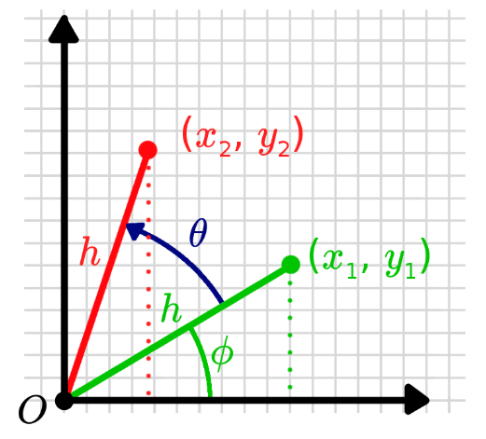
Rotation matrix
x=r.cos φ
y=r.sin φ
P(x,y) = P(r.cosφ,r.sinφ)
P’(x’,y’)=P[r.cos(φ+θ),r.sin(φ+θ)]
The coordinates of P’ are:
x’=r.cos(θ+φ)=r(cosθcosφ-sinθsinφ)
=x.cosθ-y.sinθ
(where x=rcosφ and y=rsinφ)
similarly;
y’= rsin(θ+φ)=r(sinθcosφ + cosθ.sinφ)
=xsinθ+ycosθ

Slide 15
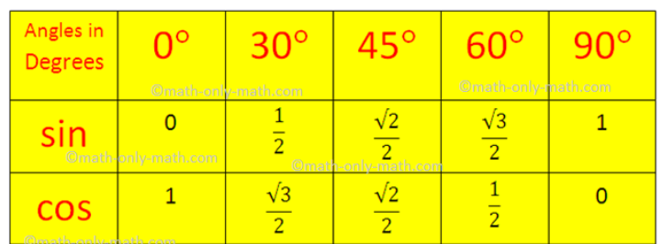
Trigonometric Table

Slide 16
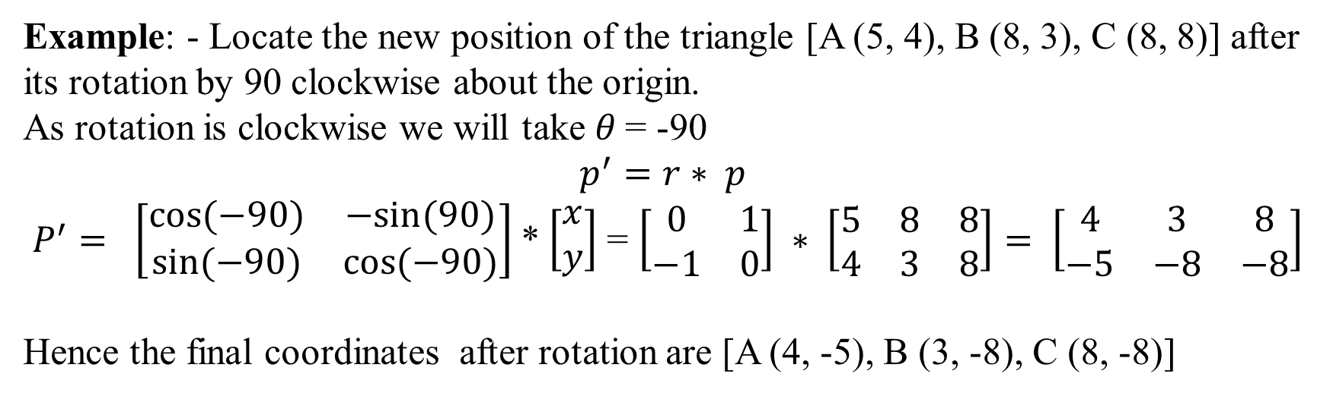
Q1:- Given a line segment with starting point as (0, 0) and ending point as (4, 4). Apply 30 degree rotation anticlockwise direction on the line segment and find out the new coordinates of the line.
Q2-Given a triangle with corner coordinates (0, 0), (1, 0) and (1, 1). Rotate the triangle by 90 degree anticlockwise direction and find out the new coordinates.
Example: - Locate the new position of the triangle [A (5, 4), B (8, 3), C (8, 8)] after its rotation by 90 clockwise about the origin.
As rotation is clockwise we will take 𝜃 = -90
$p^{′}=r∗ p$
$P^{′}= \left[\begin{matrix}cos(−90) & −sin(90) \\ \sin{(−90)} & cos(−90)\end{matrix}\right]$*$\left[\begin{aligned}x \\ y\end{aligned}\right]$ = $\left[\begin{matrix}0 & 1 \\ −1 & 0\end{matrix}\right] ∗ \left[\begin{matrix}5 & 8 & 8 \\ 4 & 3 & 8\end{matrix}\right]= \left[\begin{matrix}4 & 3 & 8 \\ −5 & −8 & −8\end{matrix}\right]$
Hence the final coordinates after rotation are [A (4, -5), B (3, -8), C (8, -8)]

Slide 17
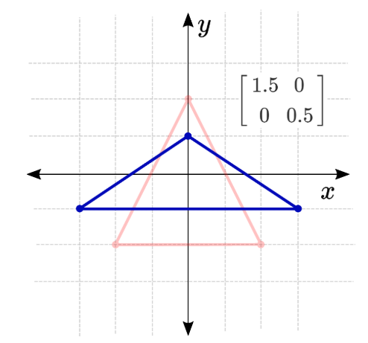
Scaling matrix

Slide 18
Q1:-Given a square object with coordinate points A(0, 3), B(3, 3), C(3, 0), D(0, 0). Apply the scaling parameter 2 towards X axis and 3 towards Y axis and obtain the new coordinates of the object.

Slide 19
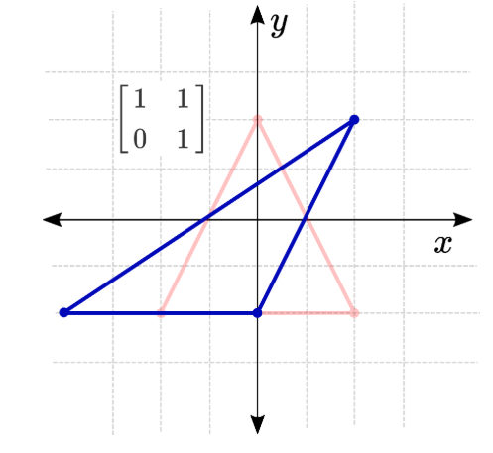
Shearing:

Slide 20
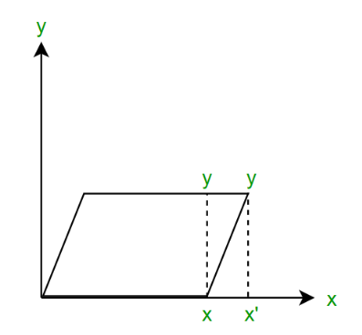
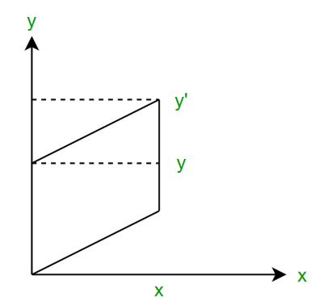
X Shear, Y Shear
Converted to a parallelogram
y
(1,1)
y
(0,1)
(2,1)
(3,1)
(0,0)
x
x
(1,0)
(0,0)
(1,0)
y
y
(2,1)
(0,1)
(1,1)
(1,1)
(1/2,0)
x
x
(0,0)
(1,0)
(3/2,0)
(0,-1)

Slide 21
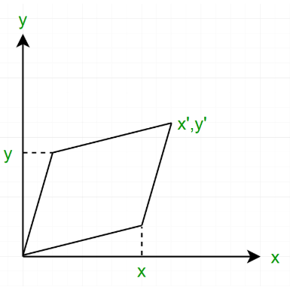
XY Shear
(0,3/2)
(1,2)
y
y
(0,1)
(1,1)
(0,1/2)
(1,1)
(0,0)
(1,0)
x
x
(-1,0)
Q: A square ABCD is given with vertices A(0,0),B(1,0),C(1,1), and D(0,1). Illustrate the effect of
x-shear
y-shear
xy-shear
on the given square, when a=2 and b=3.
Ans:
A’=(0,0), B’=(1,0), C’=(3,1) and D’=(2,1)
A’=(0,0), B’=(1,3), C’=(1,4) and D’=(0,1)
A’=(0,0), B’=(1,3), C’=(3,4) and D’=(2,1)

Slide 22
Basic 2D Transformations
Basic 2D transformations as 3x3 Matrices
Translate
Scale
Rotate
Shear
cgvr.korea.ac.kr

Slide 23
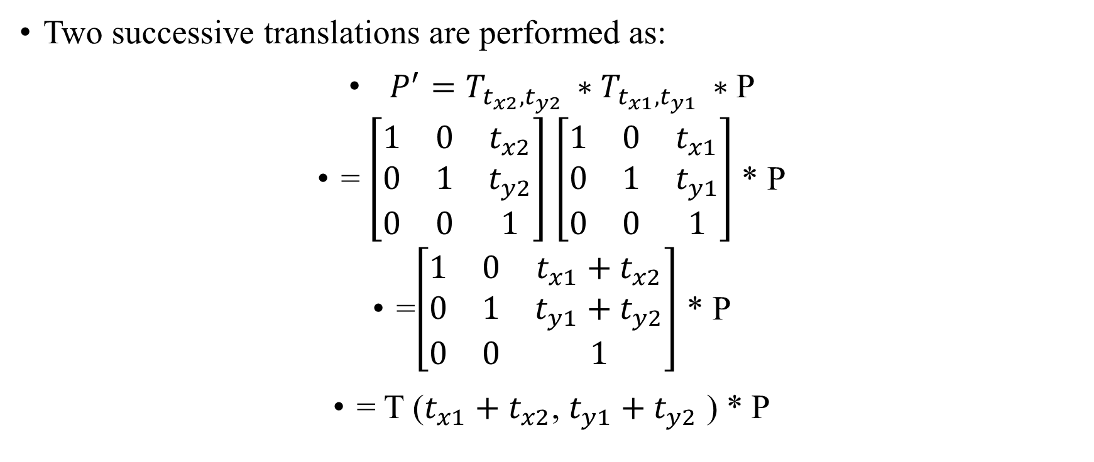
Composite transformation
Two successive translations are performed as:
$P^{′}=T_{t_{x2}, t_{y2} }∗T_{t_{x1}, t_{y1} }∗$P
= $\left[\begin{matrix}1 & 0 & t_{x2} \\ 0 & 1 & t_{y2} \\ 0 & 0 & 1\end{matrix}\right]$ $\left[\begin{matrix}1 & 0 & t_{x1} \\ 0 & 1 & t_{y1} \\ 0 & 0 & 1\end{matrix}\right]$ * P
=$\left[\begin{matrix}1 & 0 & t_{x1}+t_{x2} \\ 0 & 1 & t_{y1}+t_{y2} \\ 0 & 0 & 1\end{matrix}\right]$ * P
= T ($t_{x1}+t_{x2}$, $t_{y1}+t_{y2}$ ) * P

Slide 24
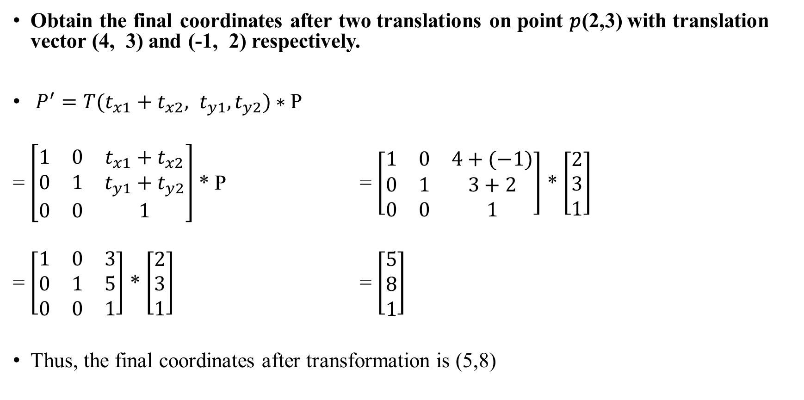
Example
Obtain the final coordinates after two translations on point 𝑝(2,3) with translation vector (4, 3) and (-1, 2) respectively.
$P^{′}=T(t_{x1}+t_{x2}, t_{y1}, t_{y2})∗$P
= $\left[\begin{matrix}1 & 0 & t_{x1}+t_{x2} \\ 0 & 1 & t_{y1}+t_{y2} \\ 0 & 0 & 1\end{matrix}\right]$ * P = $\left[\begin{matrix}1 & 0 & 4+(−1) \\ 0 & 1 & 3+2 \\ 0 & 0 & 1\end{matrix}\right]$ * $\left[\begin{aligned}2 \\ 3 \\ 1\end{aligned}\right]$
= $\left[\begin{matrix}1 & 0 & 3 \\ 0 & 1 & 5 \\ 0 & 0 & 1\end{matrix}\right]$ * $\left[\begin{aligned}2 \\ 3 \\ 1\end{aligned}\right]$ = $\left[\begin{aligned}5 \\ 8 \\ 1\end{aligned}\right]$
Thus, the final coordinates after transformation is (5,8)

Slide 25
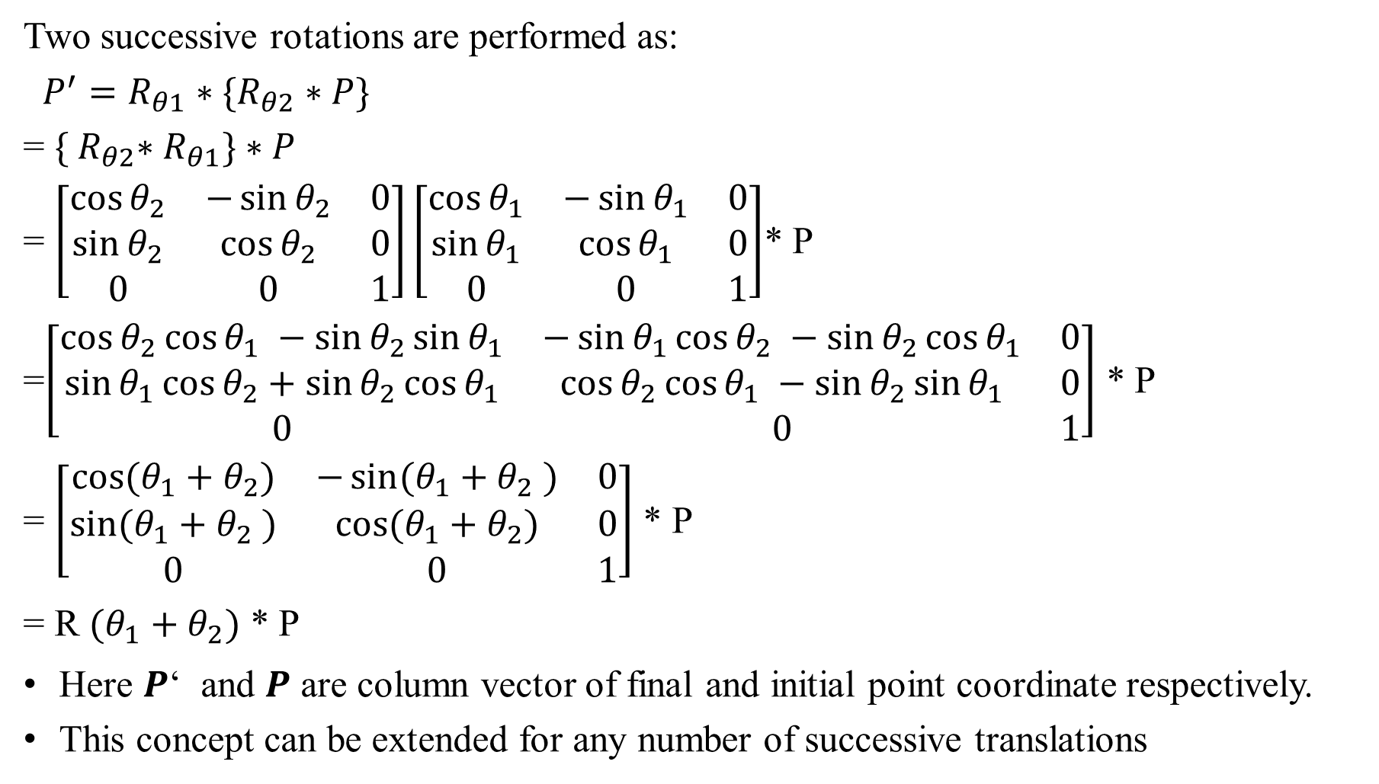
Rotations
Two successive rotations are performed as:
$P^{′}=R_{θ1}∗\{R_{θ2}∗P\}$
= ${\{ R}_{θ2}∗R_{θ1}\}∗P$
= $\left[\begin{matrix}\cos{θ_{2}} & −\sin{θ_{2}} & 0 \\ \sin{θ_{2}} & \cos{θ_{2}} & 0 \\ 0 & 0 & 1\end{matrix}\right]\left[\begin{matrix}\cos{θ_{1}} & −\sin{θ_{1}} & 0 \\ \sin{θ_{1}} & \cos{θ_{1}} & 0 \\ 0 & 0 & 1\end{matrix}\right]$* P
=$\left[\begin{matrix}\cos{θ_{2}}\cos{θ_{1} −\sin{θ_{2}\sin{θ_{1}}}} & −\sin{θ_{1}\cos{θ_{2} −\sin{θ_{2}\cos{θ_{1}}}}} & 0 \\ \sin{θ_{1}\cos{θ_{2}+\sin{θ_{2}\cos{θ_{1}}}}} & \cos{θ_{2}}\cos{θ_{1} −\sin{θ_{2}\sin{θ_{1}}}} & 0 \\ 0 & 0 & 1\end{matrix}\right]$ * P
= $\left[\begin{matrix}\cos{{(θ_{1}+θ}_{2})} & −\sin{{(θ_{1}+θ}_{2} )} & 0 \\ \sin{{(θ_{1}+θ}_{2} )} & \cos{{(θ_{1}+θ}_{2})} & 0 \\ 0 & 0 & 1\end{matrix}\right]$ * P
= R ${(θ_{1}+θ}_{2})$ * P
Here 𝑷‘ and 𝑷 are column vector of final and initial point coordinate respectively.
This concept can be extended for any number of successive translations

Slide 26
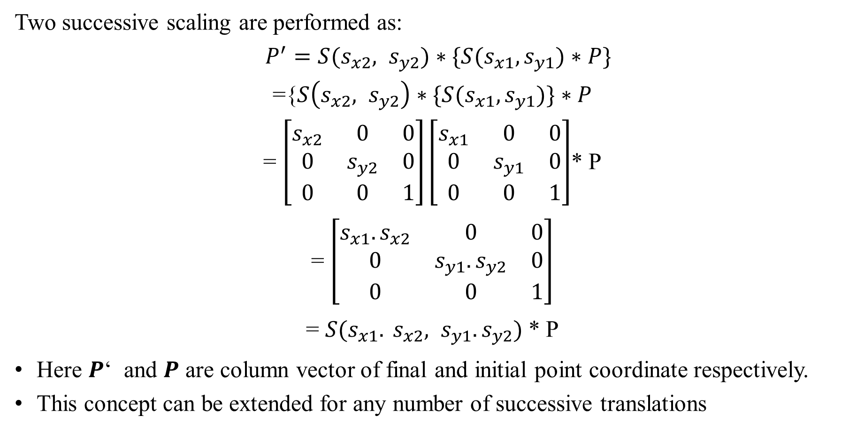
Scaling
Two successive scaling are performed as:
$P^{′}=S(s_{x2}, s_{y2})∗\{S(s_{x1},s_{y1})∗P\}$
={$S\left(s_{x2}, s_{y2}\right)∗\{S(s_{x1},s_{y1})\}∗P$
= $\left[\begin{matrix}s_{x2} & 0 & 0 \\ 0 & s_{y2} & 0 \\ 0 & 0 & 1\end{matrix}\right]\left[\begin{matrix}s_{x1} & 0 & 0 \\ 0 & s_{y1} & 0 \\ 0 & 0 & 1\end{matrix}\right]$* P
= $\left[\begin{matrix}s_{x1}.s_{x2} & 0 & 0 \\ 0 & s_{y1}.s_{y2} & 0 \\ 0 & 0 & 1\end{matrix}\right]$
= $S(s_{x1}. s_{x2}, s_{y1}.s_{y2})$* P
Here 𝑷‘ and 𝑷 are column vector of final and initial point coordinate respectively.
This concept can be extended for any number of successive translations

Slide 27
Matrix Composition
Transformations can be combined by matrix multiplication
Efficiency with premultiplication
Matrix multiplication is associative

Slide 28
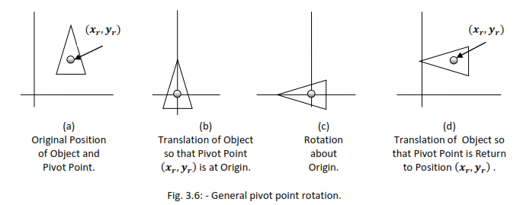
General pivot –point Rotation
For rotating object about arbitrary point called pivot point we need to apply following sequence of transformation.
Translate the object so that the pivot-point coincides with the coordinate origin.
Rotate the object about the coordinate origin with specified angle.
Translate the object so that the pivot-point is returned to its original position (i.e. Inverse of step-1).

Slide 29
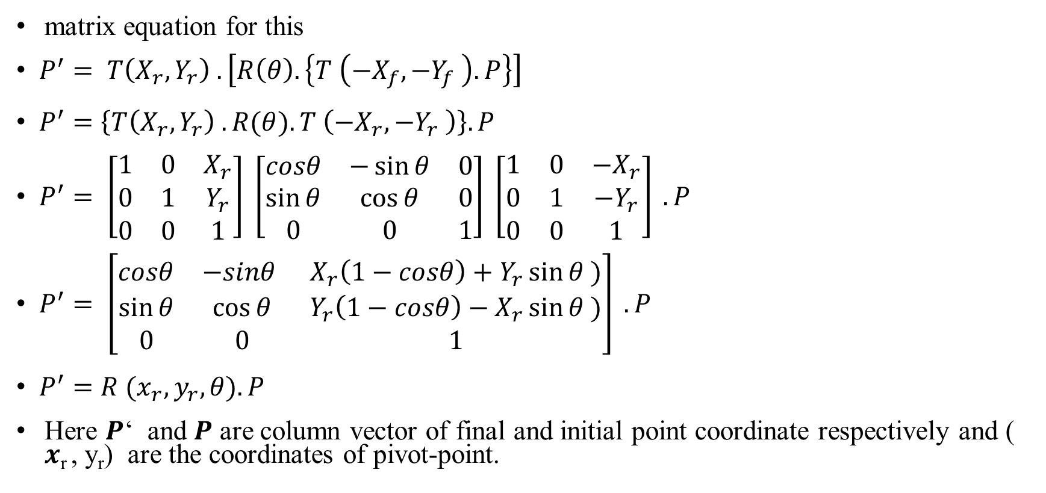
matrix equation for this
$P^{′}= T\left(X_{r}, Y_{r}\right) . \left[R\left(θ\right). \left\{T \left(−X_{f}, −Y_{f} \right). P\right\}\right]$
$P^{′}=\left\{T\left(X_{r}, Y_{r}\right) . R(θ). T \left(−X_{r}, −Y_{r} \right)\right\}. P$
$P^{′}= \left[\begin{matrix}1 & 0 & X_{r} \\ 0 & 1 & Y_{r} \\ 0 & 0 & 1\end{matrix}\right] \left[\begin{matrix}cosθ & −\sin{θ} & 0 \\ \sin{θ} & \cos{θ} & 0 \\ 0 & 0 & 1\end{matrix}\right] \left[\begin{matrix}1 & 0 & {−X}_{r} \\ 0 & 1 & {−Y}_{r} \\ 0 & 0 & 1\end{matrix}\right] . P$
$P^{′}= \left[\begin{matrix}cosθ & −sinθ & X_{r}\left(1−cosθ\right)+Y_{r}\sin{θ} ) \\ \sin{θ} & \cos{θ} & Y_{r}\left(1−cosθ\right)−X_{r}\sin{θ} ) \\ 0 & 0 & 1\end{matrix}\right] . P$
$P^{′}=R (x_{r}, y_{r}, θ). P$
Here 𝑷‘ and 𝑷 are column vector of final and initial point coordinate respectively and ( 𝒙_{r} , y_{r}) are the coordinates of pivot-point.

Slide 30
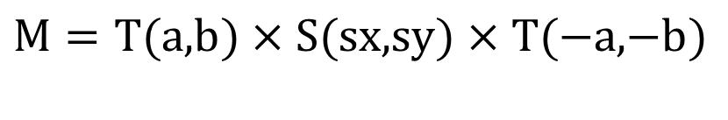

Matrix Composition
Rotate by θ around arbitrary point (a,b)
Scale by sx, sy around arbitrary point (a,b)
(a,b)
$$M=T(\text{a}\text{,}\text{b})×R(θ)×T(\text{−}\text{a}\text{,−}\text{b})$$
$$M=T(\text{a}\text{,}\text{b})×S(\text{sx}\text{,}\text{sy})×T(\text{−}\text{a}\text{,−}\text{b})$$
(a,b)

Slide 31
Pivot-Point Rotation
(x_{r},y_{r})
(x_{r},y_{r})
(x_{r},y_{r})
(x_{r},y_{r})
Translate
Rotate
Translate

Slide 32
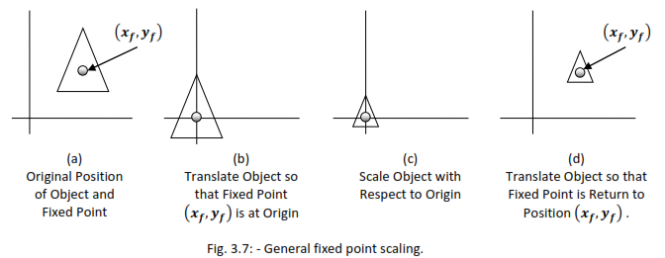
General Fixed-Point Scaling

